Slide 1
Second Zone
Developer by : Evan Alif Saputra Ugi Ispoyo Widodo

Slide 2
System Analysis
SecondZone is news website contains a collection of news taken from other news website
The Website will be used by two types of user:
User
Admin
For Front-End User can do:
View News
For Back-End Admin can do:
Add, Update, and Delete Admin Data
Add, Update, and Delete News Category
Add, Update, and Delete News

Slide 3
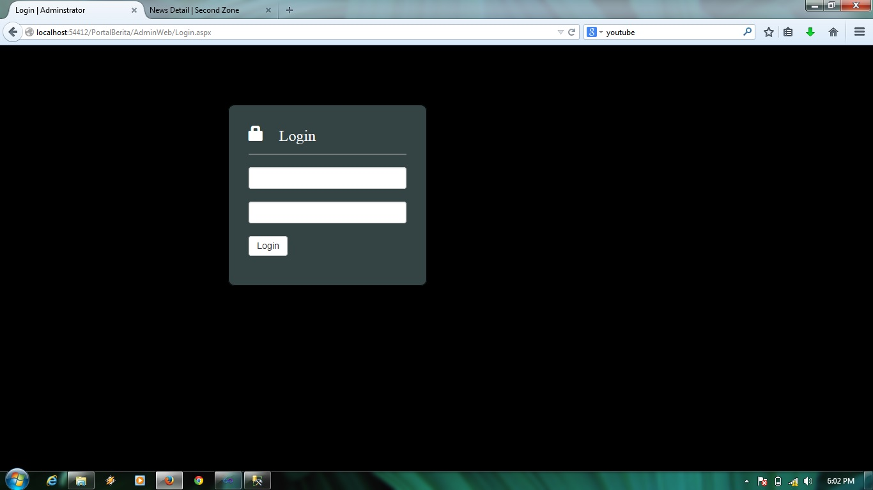
Backend From Second Zone Website

Slide 4
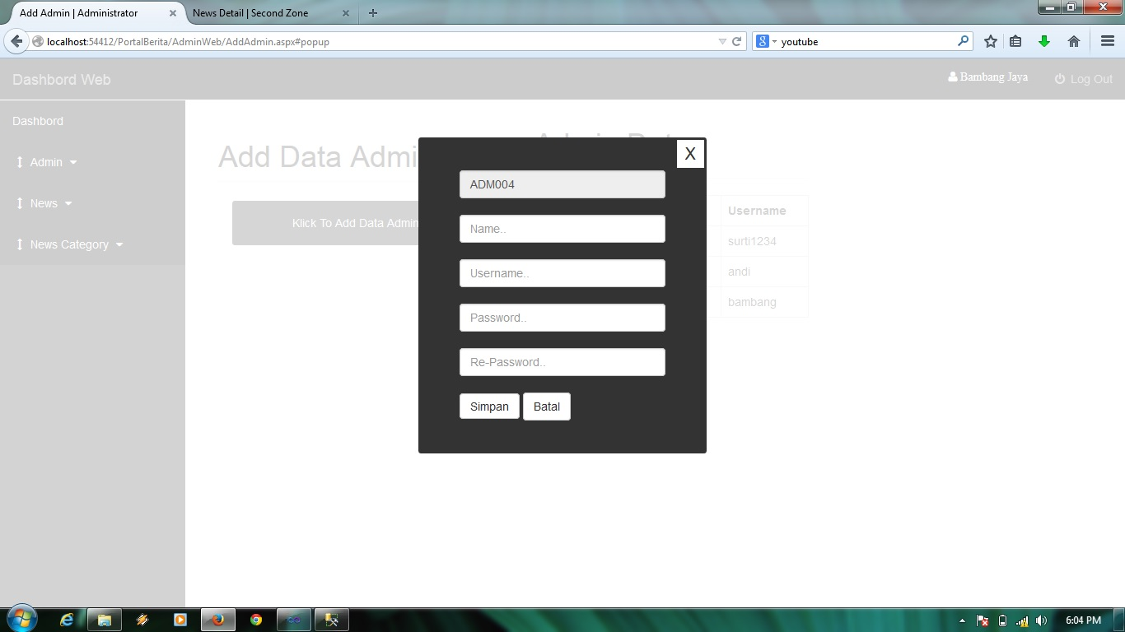
Add Admin Page

Slide 5
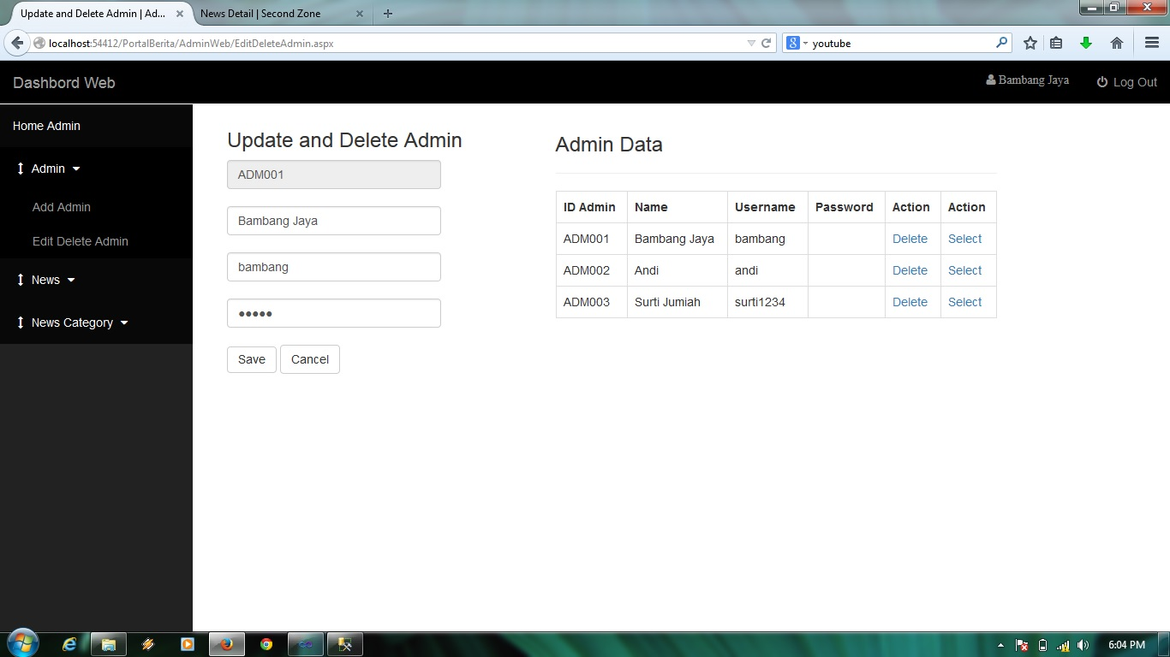
Edit Admin Page

Slide 6

Add News Page

Slide 7
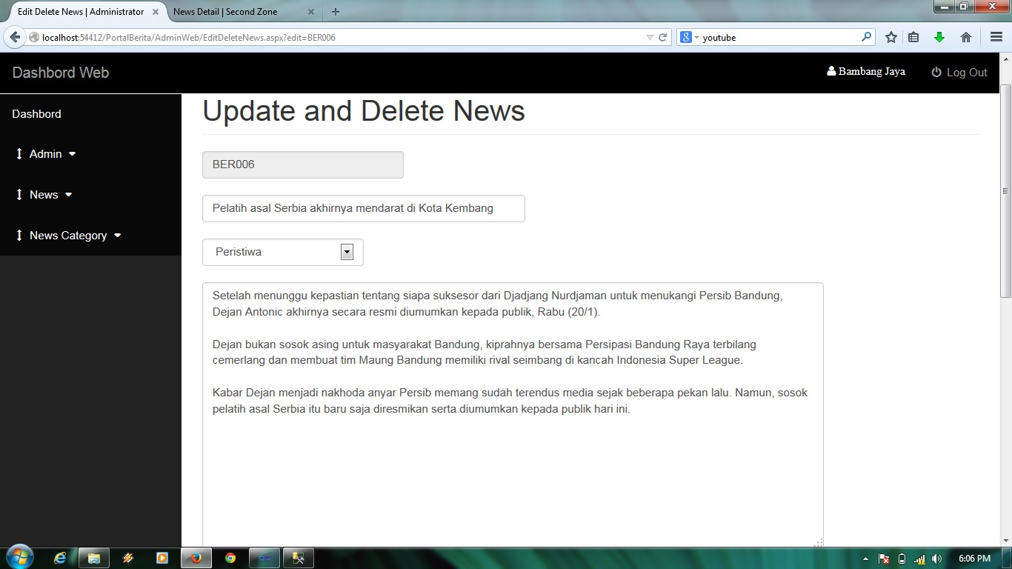
Edit News Page

Slide 8
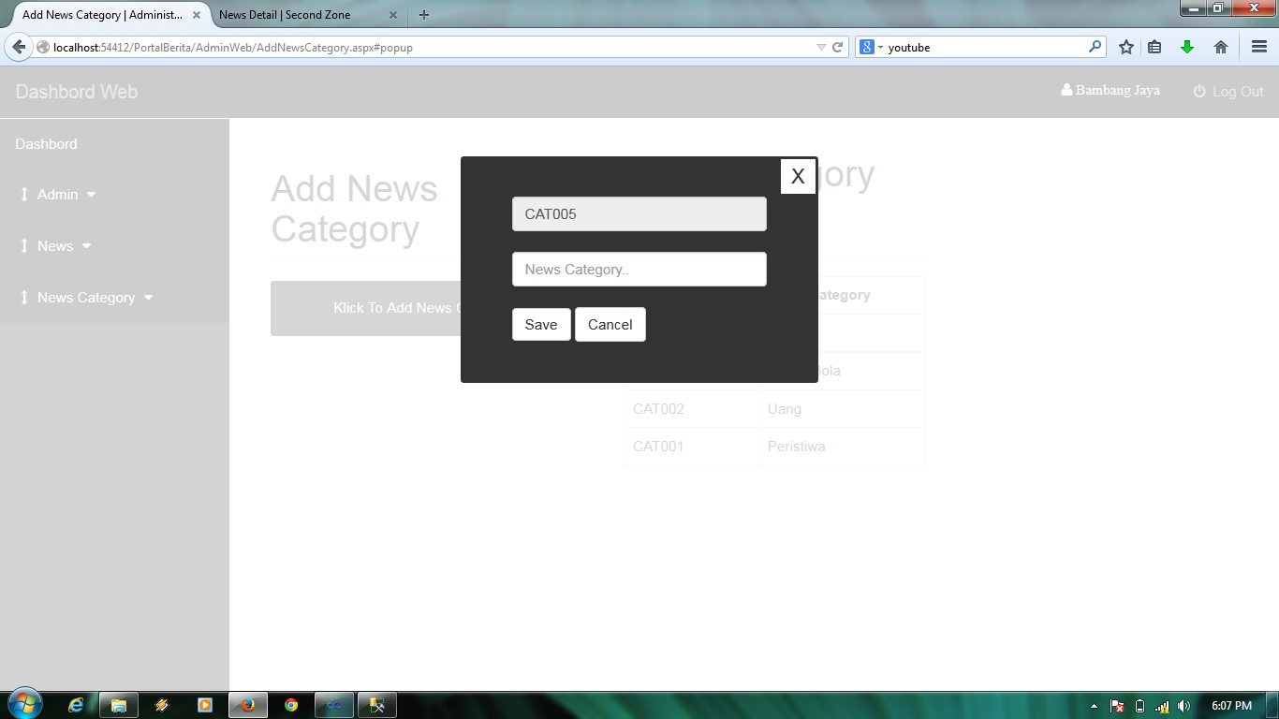
Add Category News Page

Slide 9
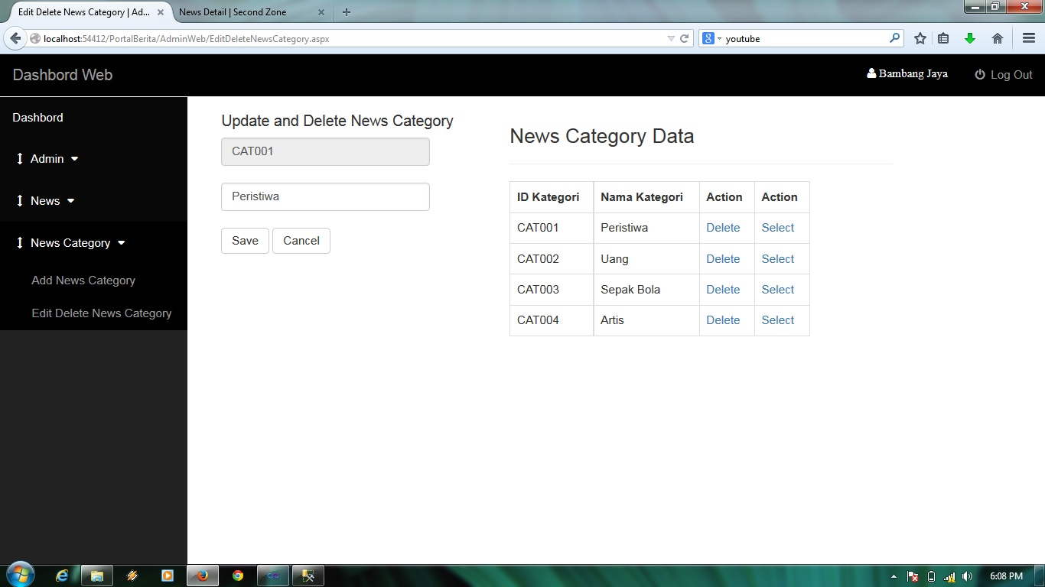
Edit Category News Page

Slide 10
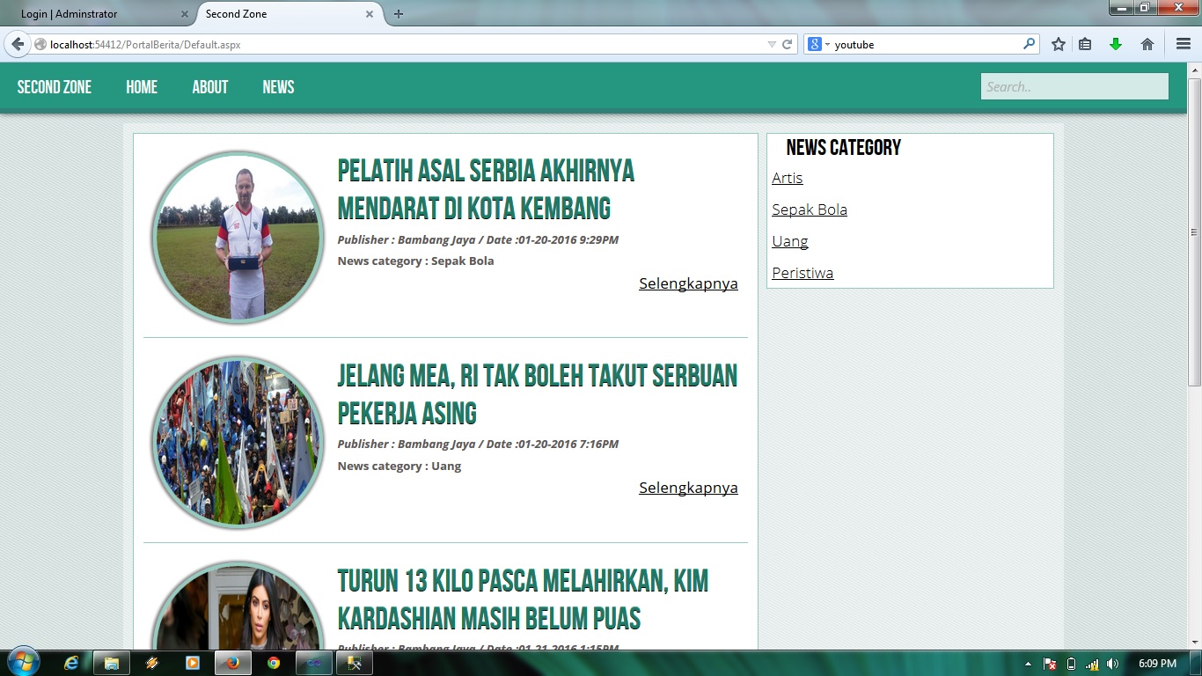
Home Page

Slide 11
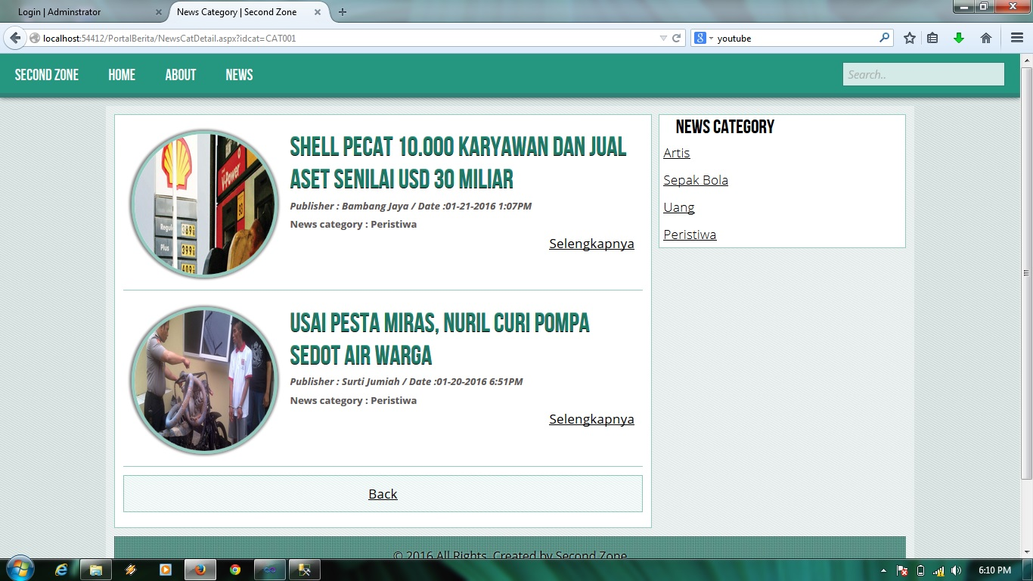
News Page

Slide 12
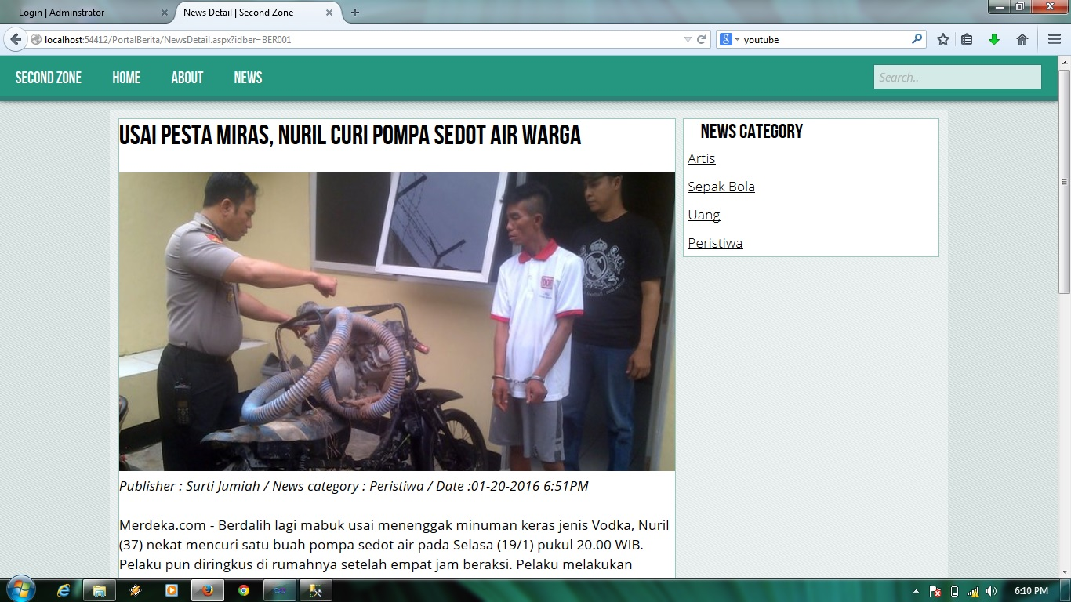
News Detail Page

Slide 13
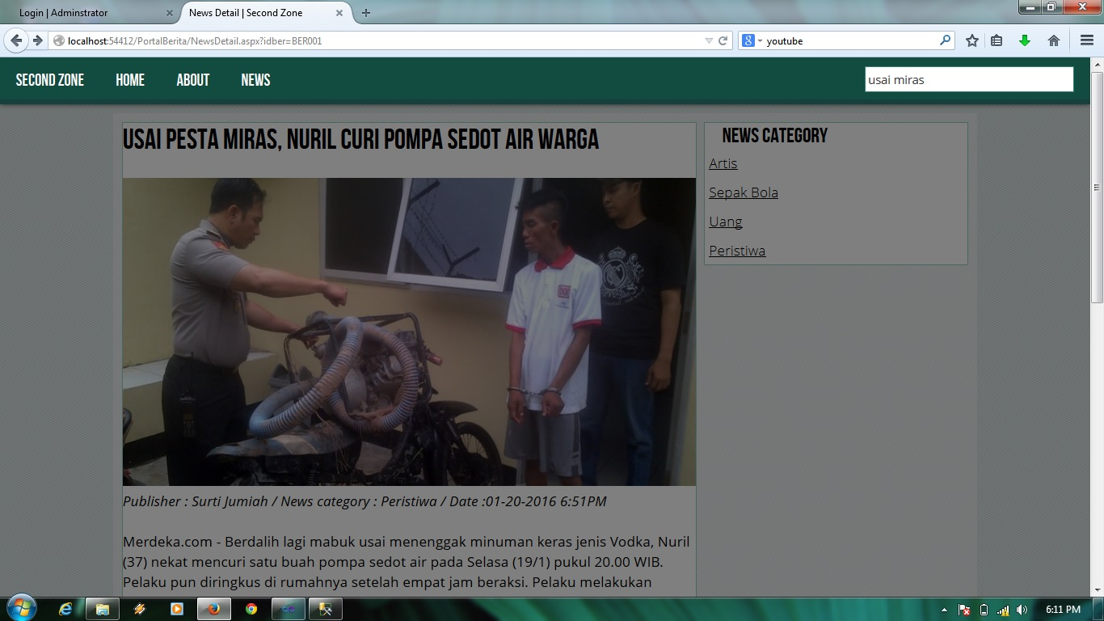
Search Page

Slide 14
Thanks You

